Slide 1
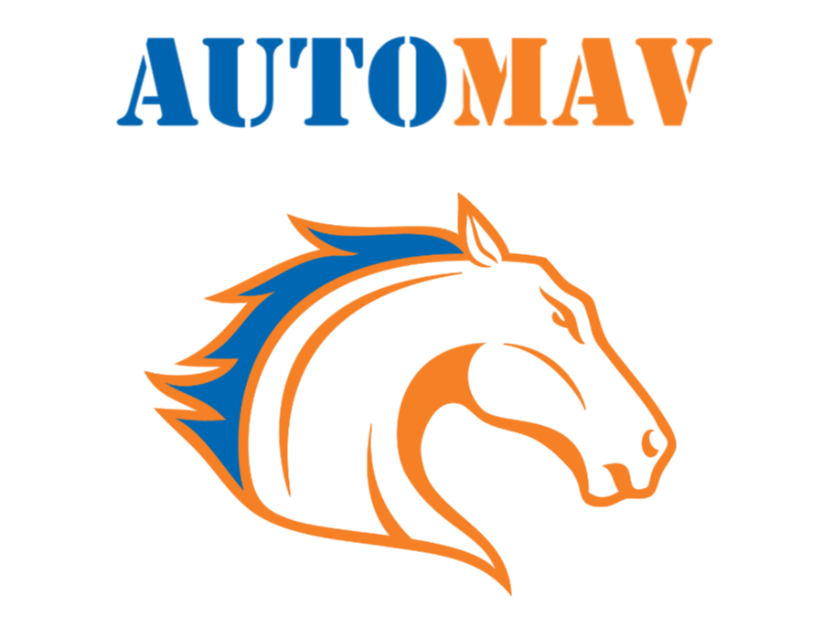
Status Update

Slide 2
Overview
Assessed and documented previous team’s vehicle configuration
Started redesigning configuration to meet the current designs
Started rebuilding chassis frame and electronics housing unit
Started setting up object recognition
Started working on gimbal mounts for cameras
Started ordering more parts
Started move to new workspace

Slide 3
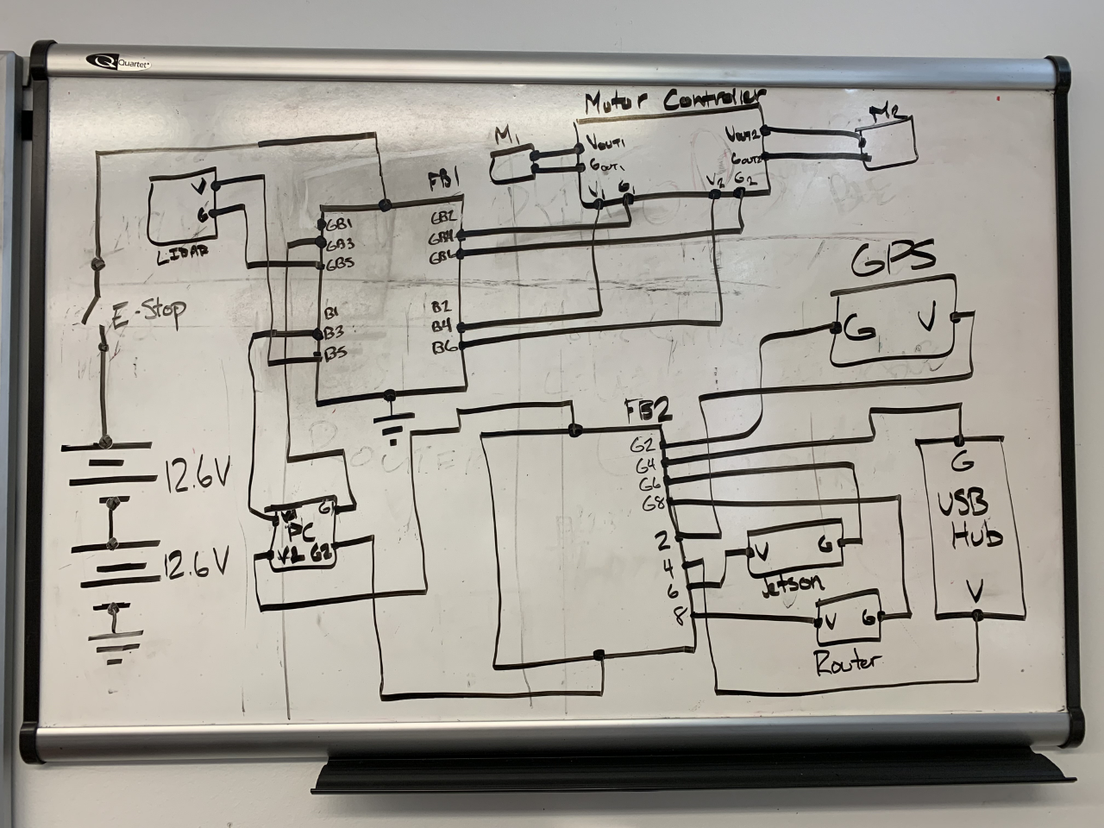

Slide 4
